Slide 1


IBM Course Seven
Week Two

Slide 2
Objectives
01
02
03
Describe data formatting techniques
Demonstrate the use of binning and of categorical variables
Identify data preprocessing techniques
Describe data normalization

Slide 3
How much do you remember?
Test your knowledge of definitions!

Slide 4
Data Formatting
Data are usually collected from different places and stored in different formats.
Bringing data into a common standard of expression allows users to make meaningful comparisons.

Slide 5
Data Types in Python
Sometimes the wrong data type is assigned to a feature.
Objects 🡪 letters or words
Int64 🡪 integers
Float64 🡪 real numbers
What’s the difference between an integer and a real number?
Notes:
Integer 🡪 whole number
Real number 🡪 decimal number

Slide 6
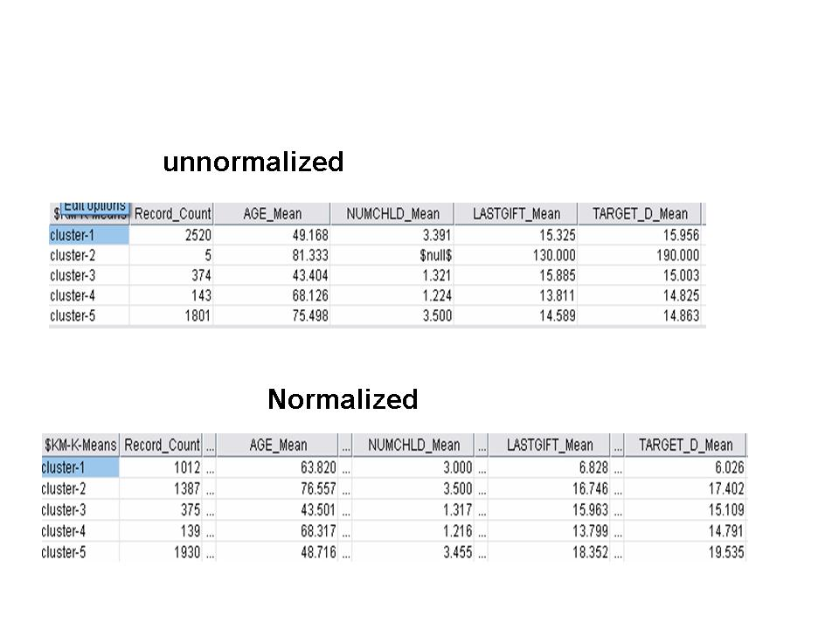
Why is data normalization important?
Notes:
https://www.novoprolabs.com/support/articles/when-and-why-do-we-need-data-normalization-201803141313.html
Keeps data consistent
Allows for fair comparisons between different features
Important for computation

Slide 7
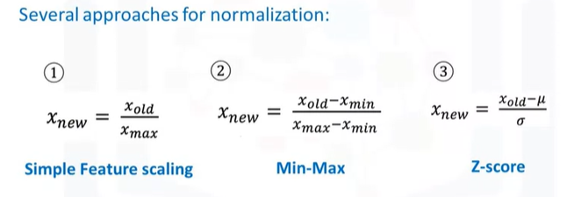
Ways to Normalize Data
Simple Feature Scaling
Min-Max
Z-score (or Standard Score)

Slide 8
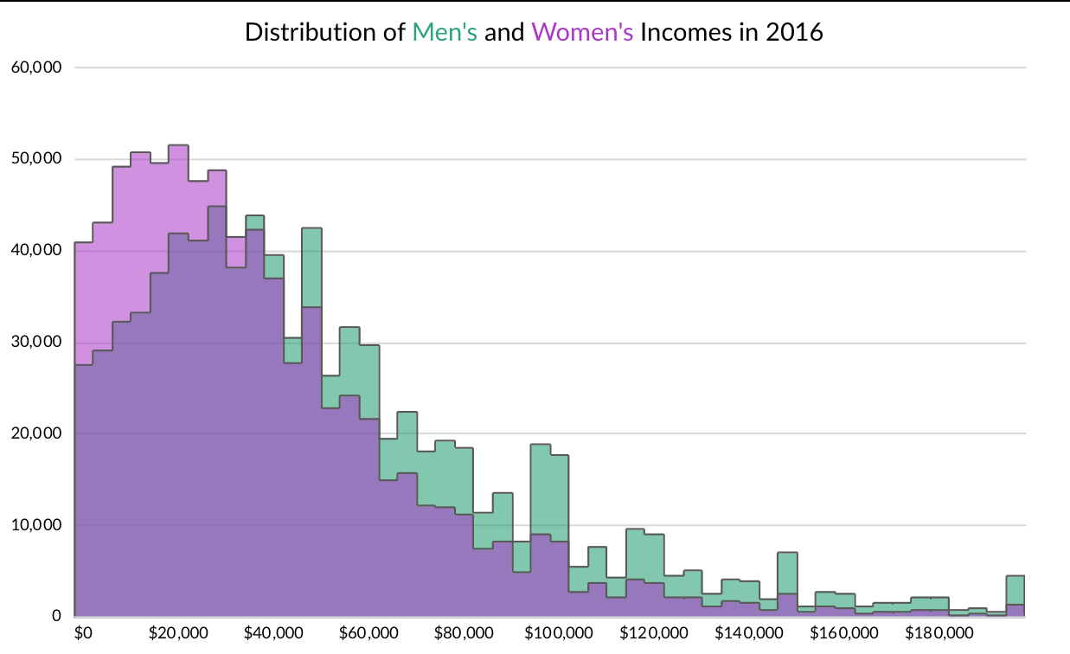
Binning
Grouping values into bins
Convert numeric into categorical variables
After data has been put into bins, what would be the best graph to use to visualize the data?
Notes:
Histograms

Slide 9
Resources to Explore!
Real Python
Repl

Slide 10
Lab and Assessment
Please spend the next 2 hours working through the lab and assessment for week 2.

